Slide 1


Slide 3


Slide 4
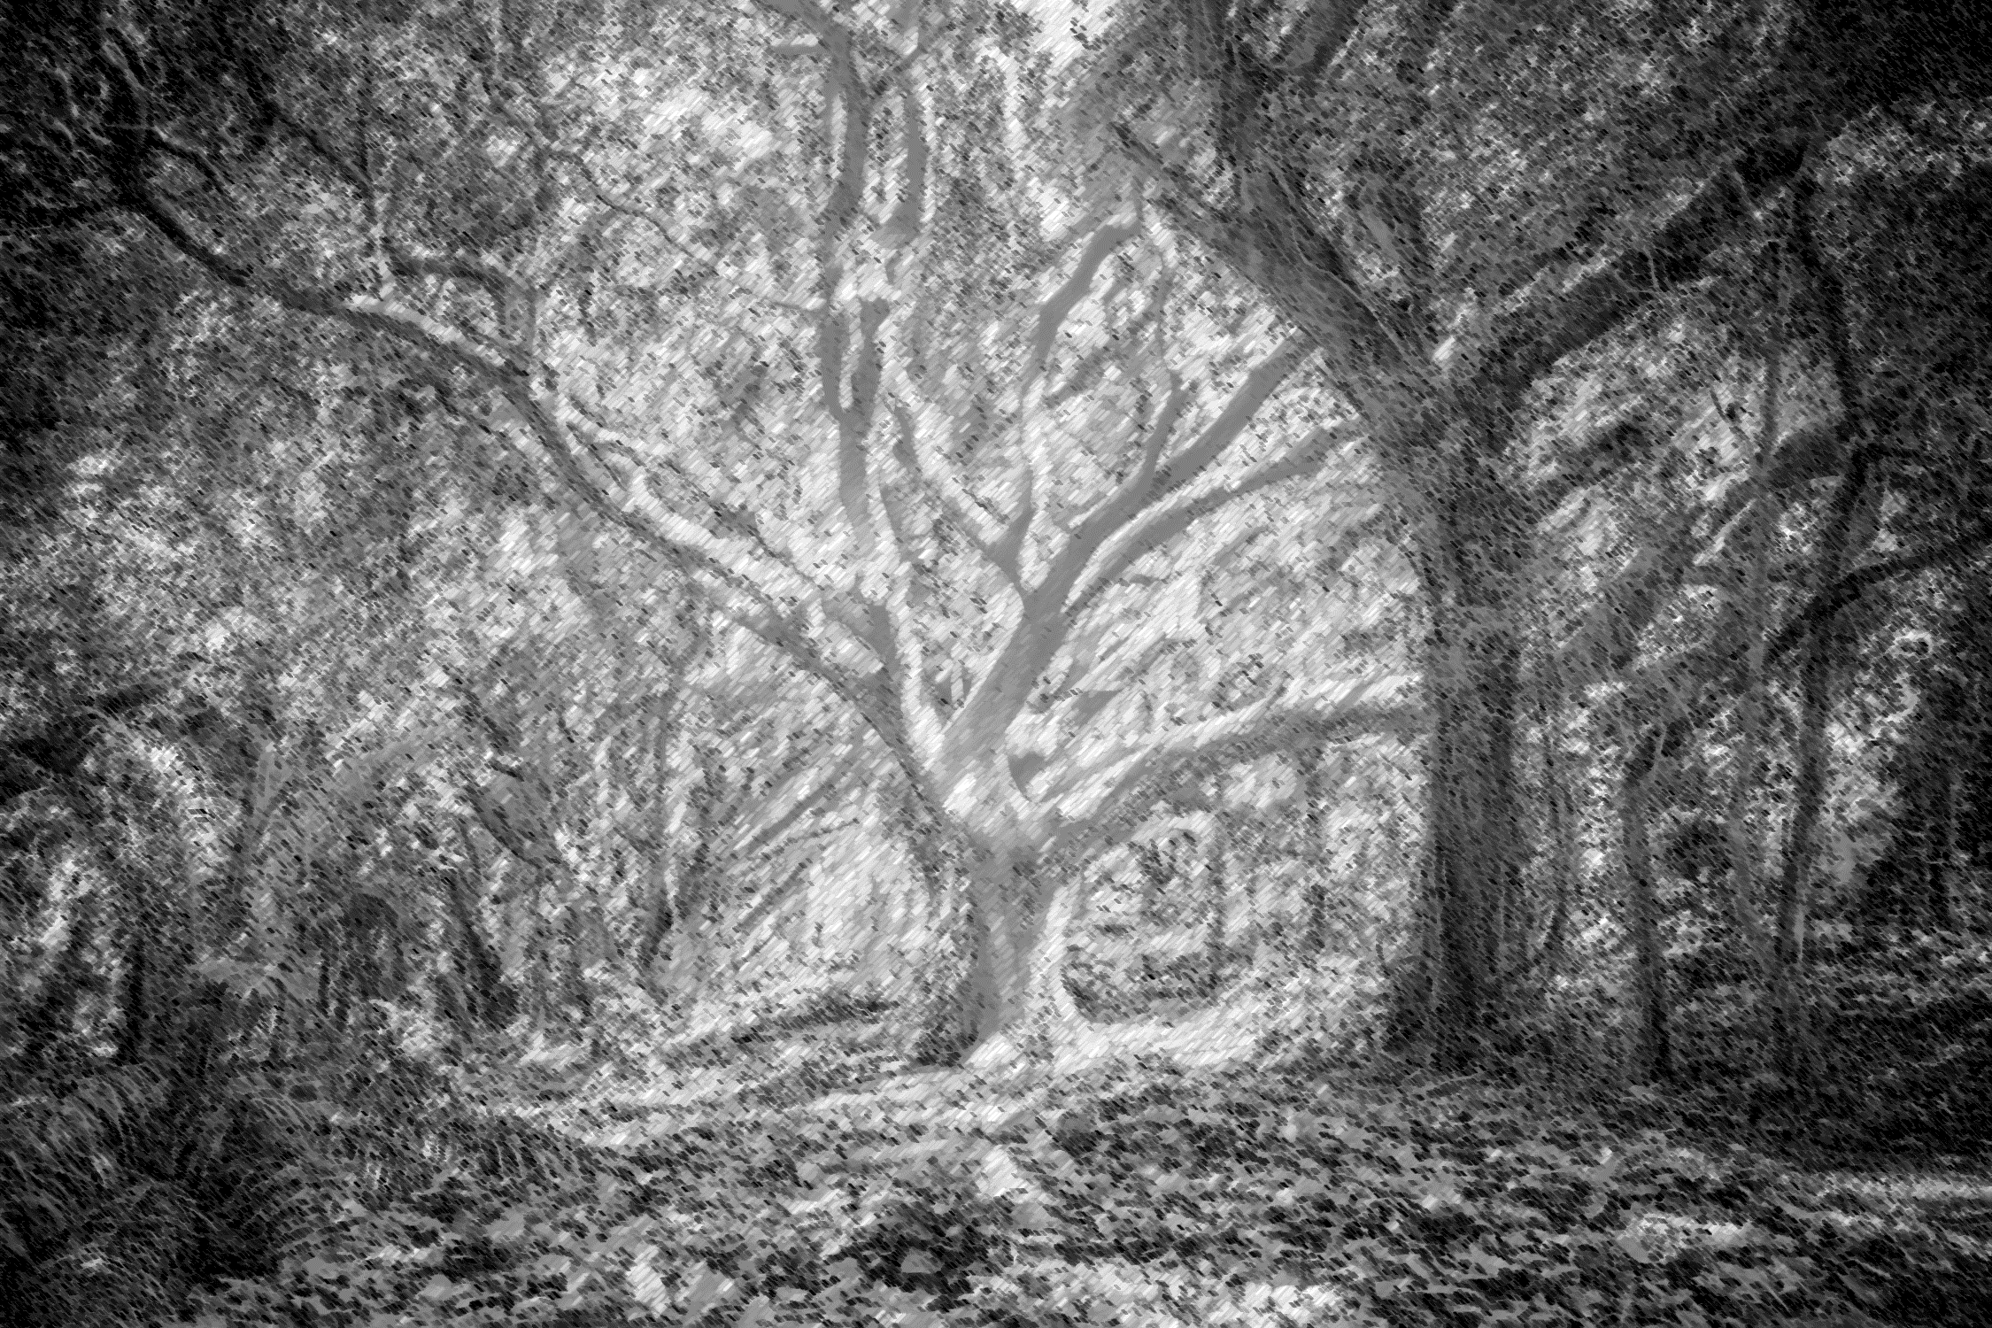
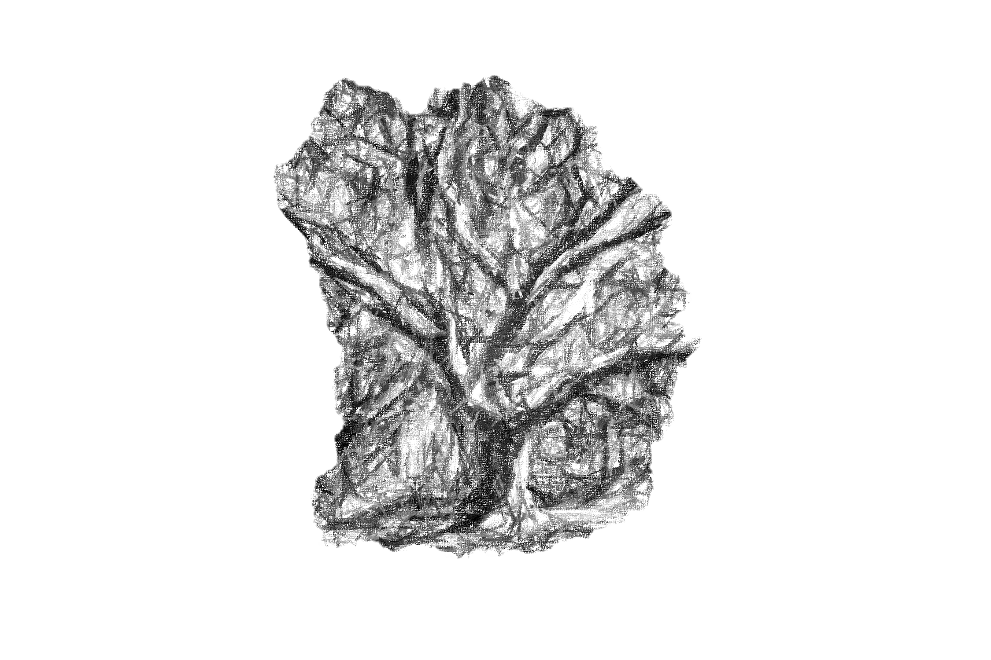
Decision
Trees

Slide 5
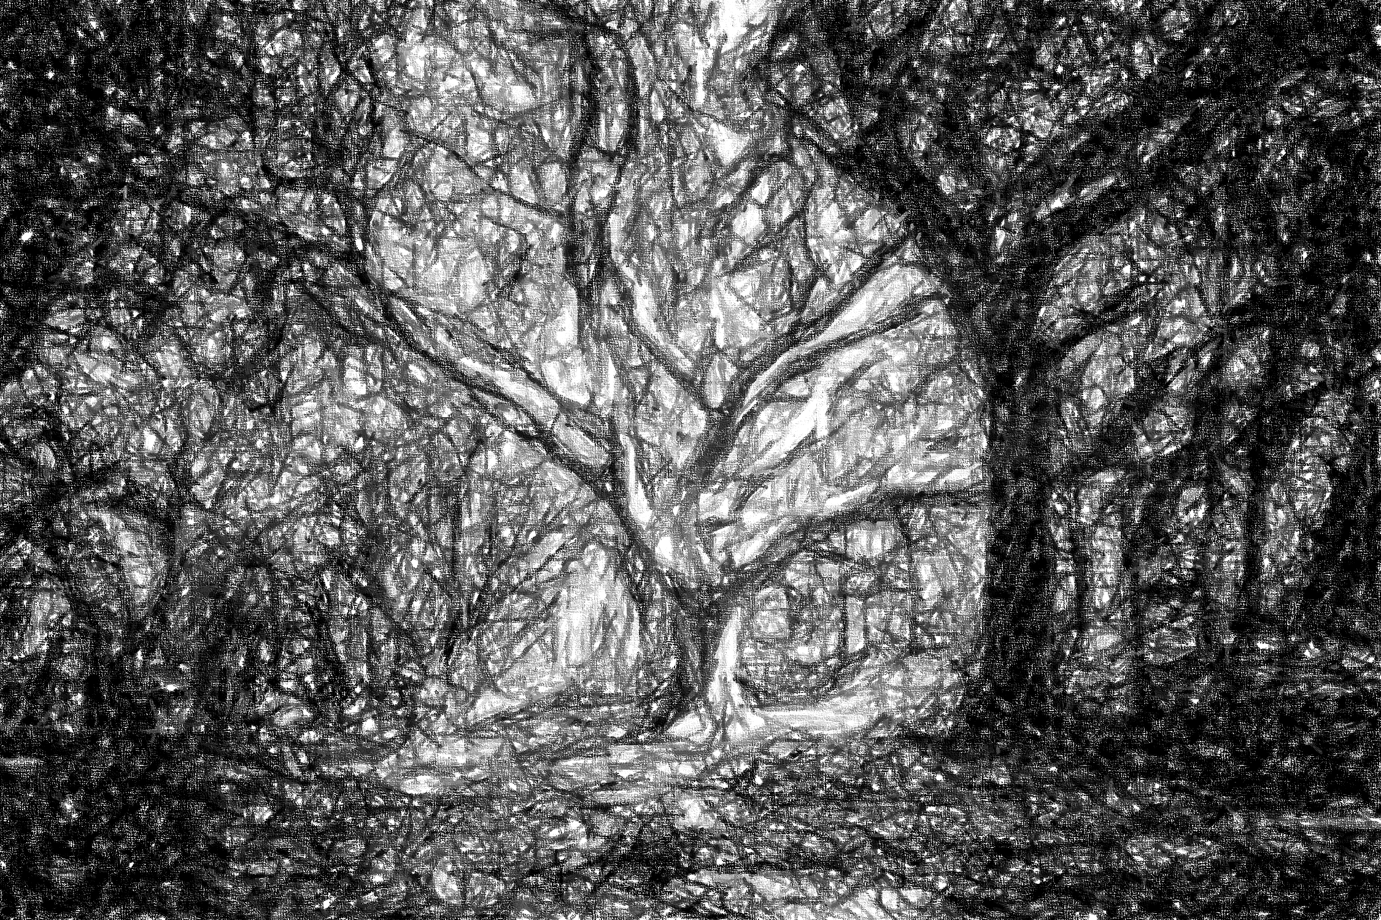
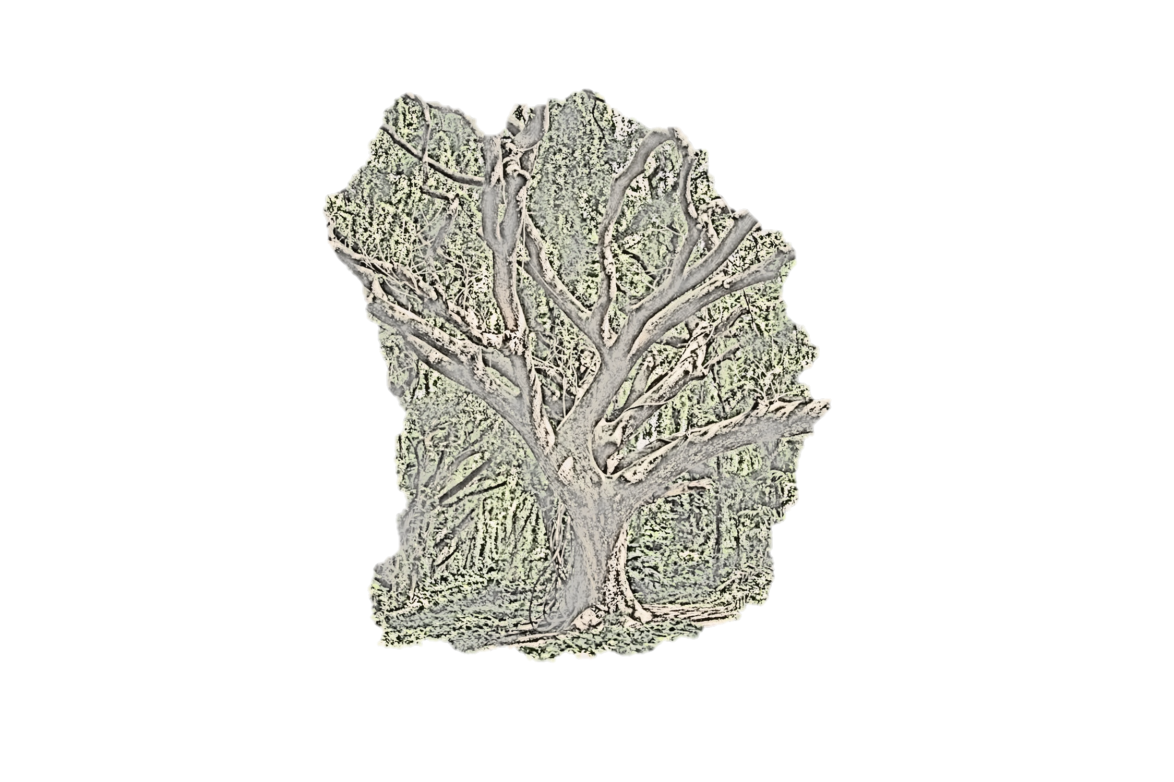

Slide 6
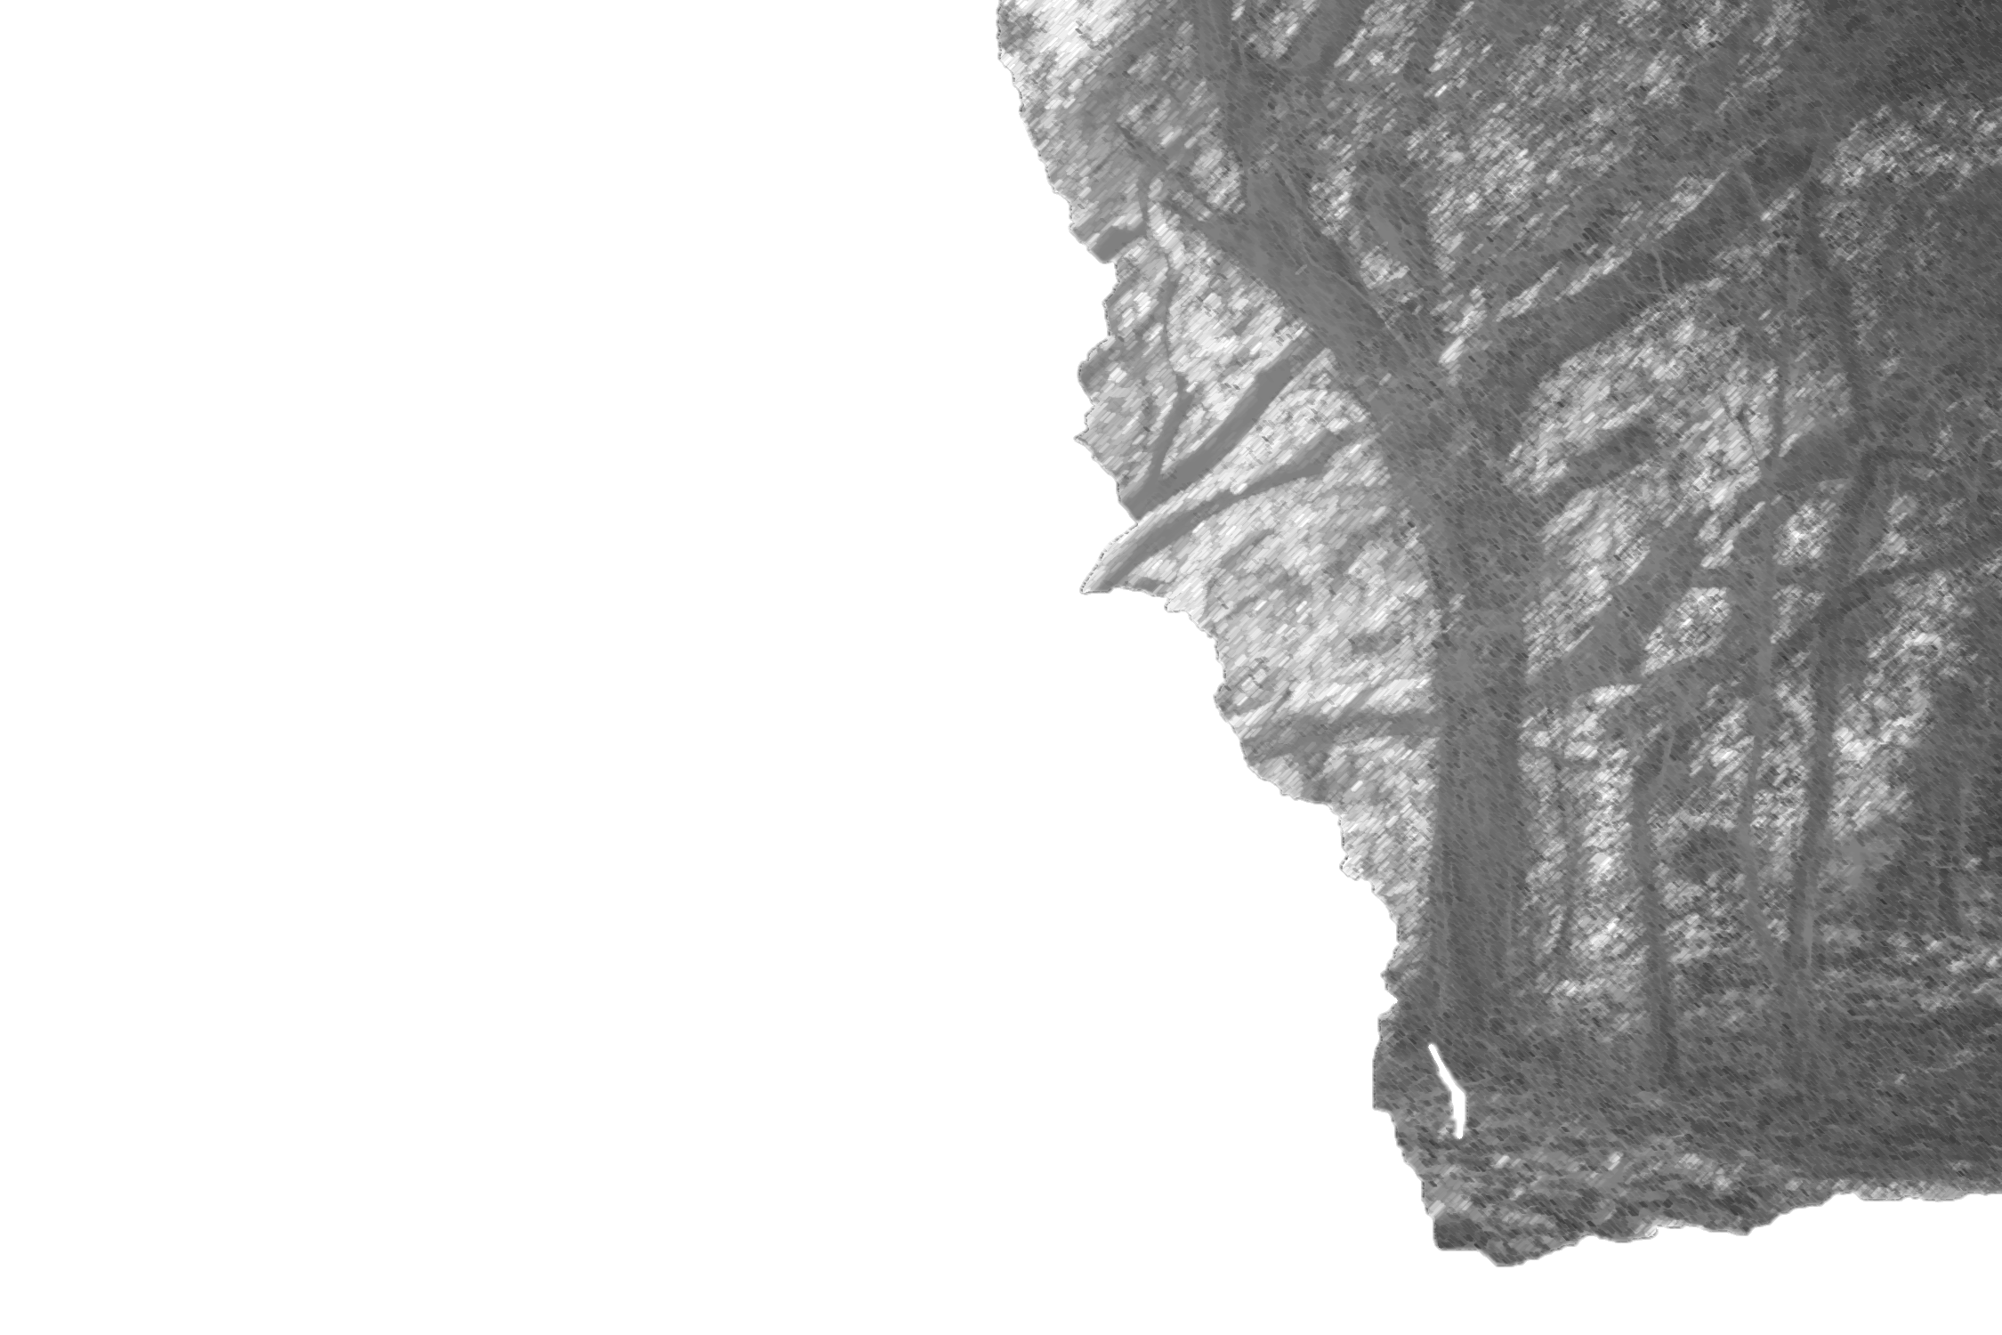

Slide 8
Root node
Interior node
Interior node
Leaf node
Leaf node
Branch
Interior node
Interior node
Leaf node
Leaf node
Leaf node
Leaf node

Slide 9
Root node
Interior node
Interior node
Leaf node
Leaf node
Interior node
Interior node
Leaf node
Leaf node
Leaf node
Leaf node

Slide 10
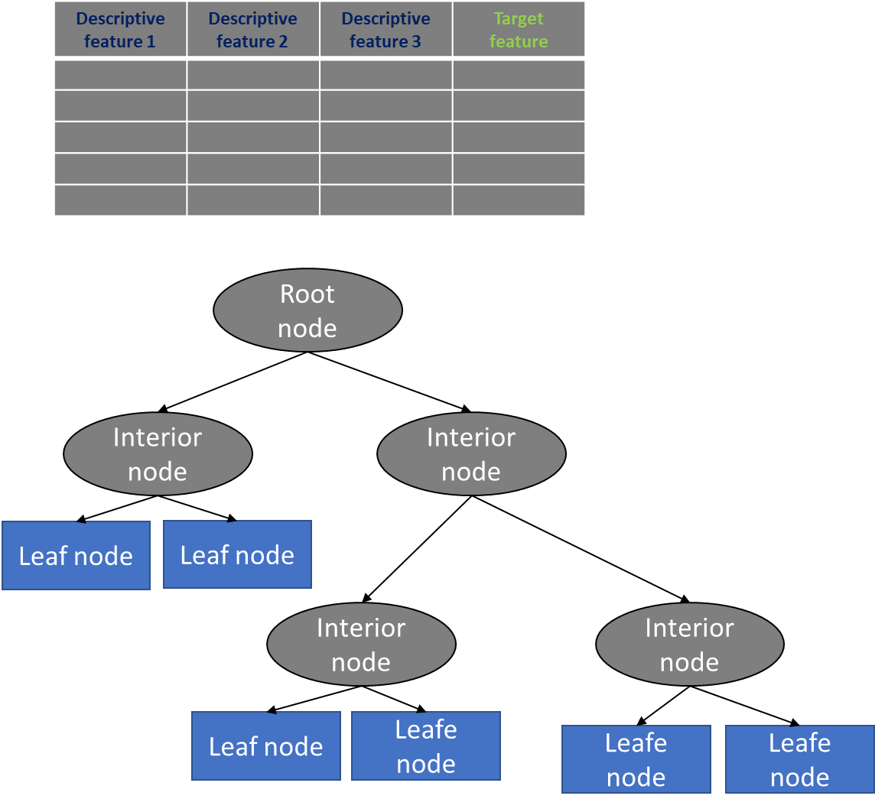
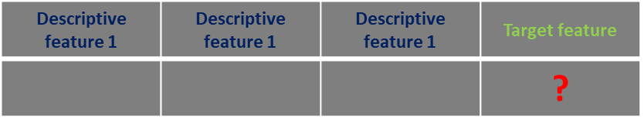
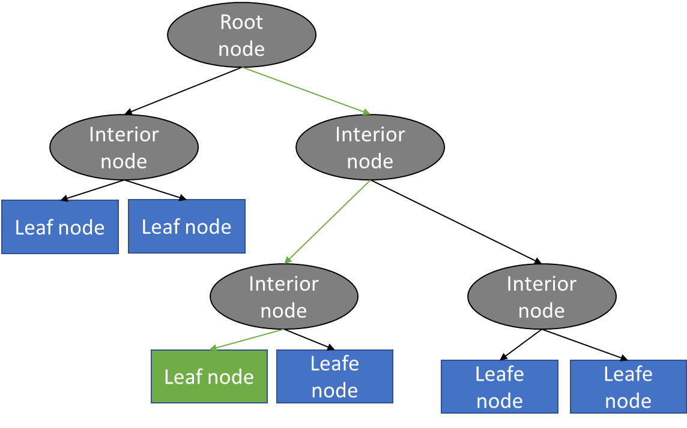
Training
Prediction
Descriptive features→ Target is unknown
Query
Descriptive features + Target feature

Slide 11
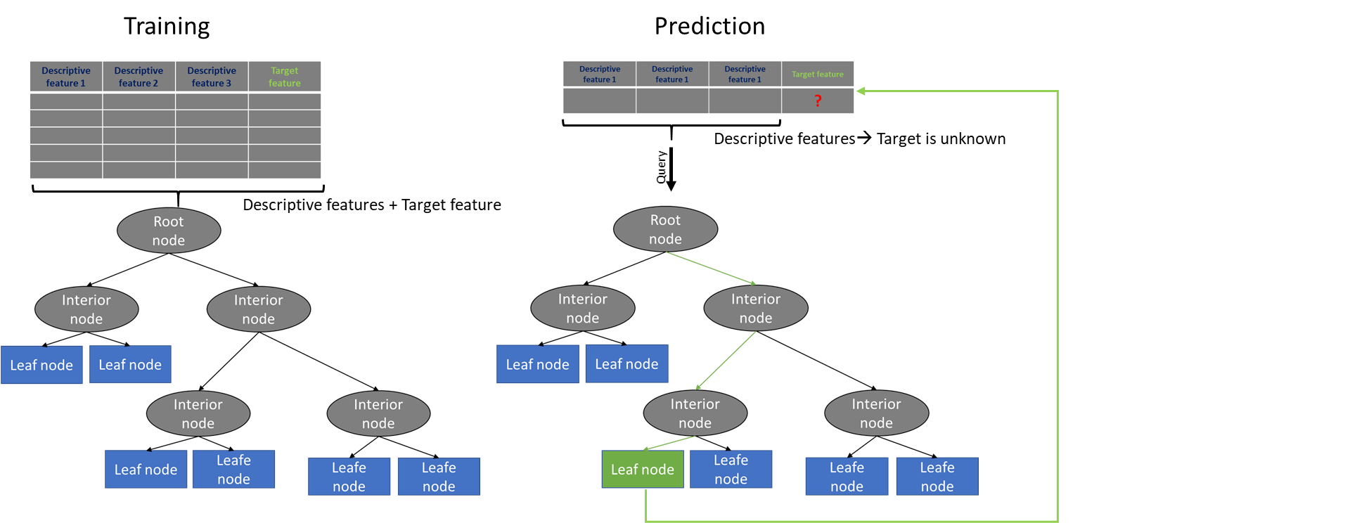
Leaf node
Leaf node
Leaf node
Leaf node
Leaf node
Leaf node

Slide 12
Categorical
Continuous
1
2
3
4
0
25
50
75
100
4 possible values
Infinite number of possible values

Slide 13
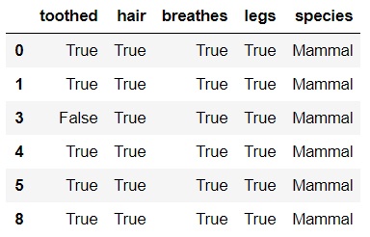
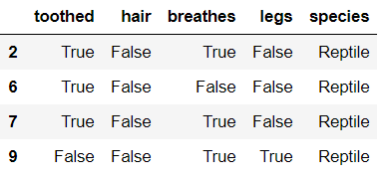
Hair
True
False
Mammal
Reptile

Slide 14
Totally pure
More impure

Slide 15
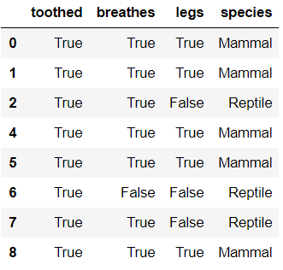
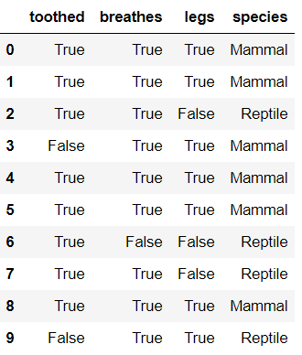
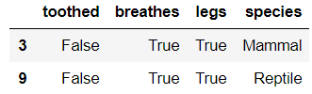
Calculate the entropy
for toothed == True
toothed == True
2. Calculate the entropy
for toothed == False
Sum up the entropies
of 1. and 2.
4. Subtract this sum
from the whole datasets
entropy → InfoGain
toothed == False
After computing the IG of feature toothed
do this for features breathes and legs

Slide 16
toothed = True ; Mammal
toothed = True ; Reptile
toothed = False ; Mammal
toothed = False ; Reptile
toothed = True
toothed = False

Slide 17
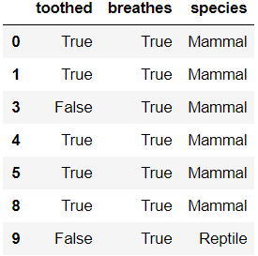
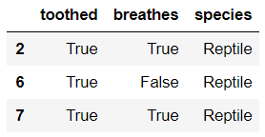
legs
True
False
Reptile

Slide 18
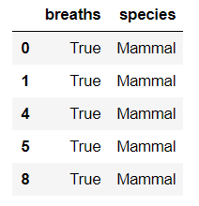
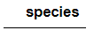
legs
True
False
Reptile
toothed
True
False
breaths
True
False
Mammal
Mammal
Mammal

Slide 19
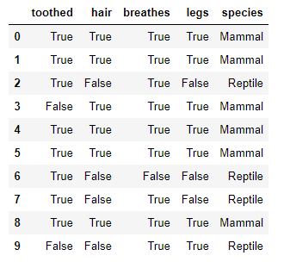
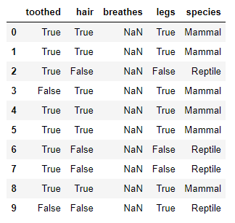
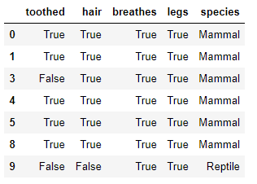
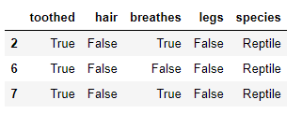
1. Create a root node
Entropy
2. Calculate the entropy of the whole (sub) dataset
3. Calculate the Information gain of each single
feature and pick that feature with the larges
Information gain
IG → toothed
IG → hair
IG → breathes
IG → legs
Select: max(IG_feature)
4. Assign the (root) node the label of the feature with the
maximum information gain. Grow for each feature value
an outgoing branch and add unlabelled nodes at the end
legs
True
False
Legs == True
Legs == False
5. Split the dataset along the values of the maximum
information gain feature and remove this feature from the
dataset
First sub tree
6. For each of the sub_datasets, repeat steps
2 to 5 until a stopping criteria is satisfied →Here the
recursion kicks in
Second sub tree

Slide 20

Advantage
Advantage
Advantage
Disadvantage
Disadvantage
Disadvantage
Disadvantage
Advantage
Advantage
Disadvantage
Advantage

Slide 21


Slide 22
Advantage
Advantage
Advantage
Disadvantage
Disadvantage
Disadvantage
Disadvantage
Advantage
Advantage
Disadvantage
Advantage

Slide 23
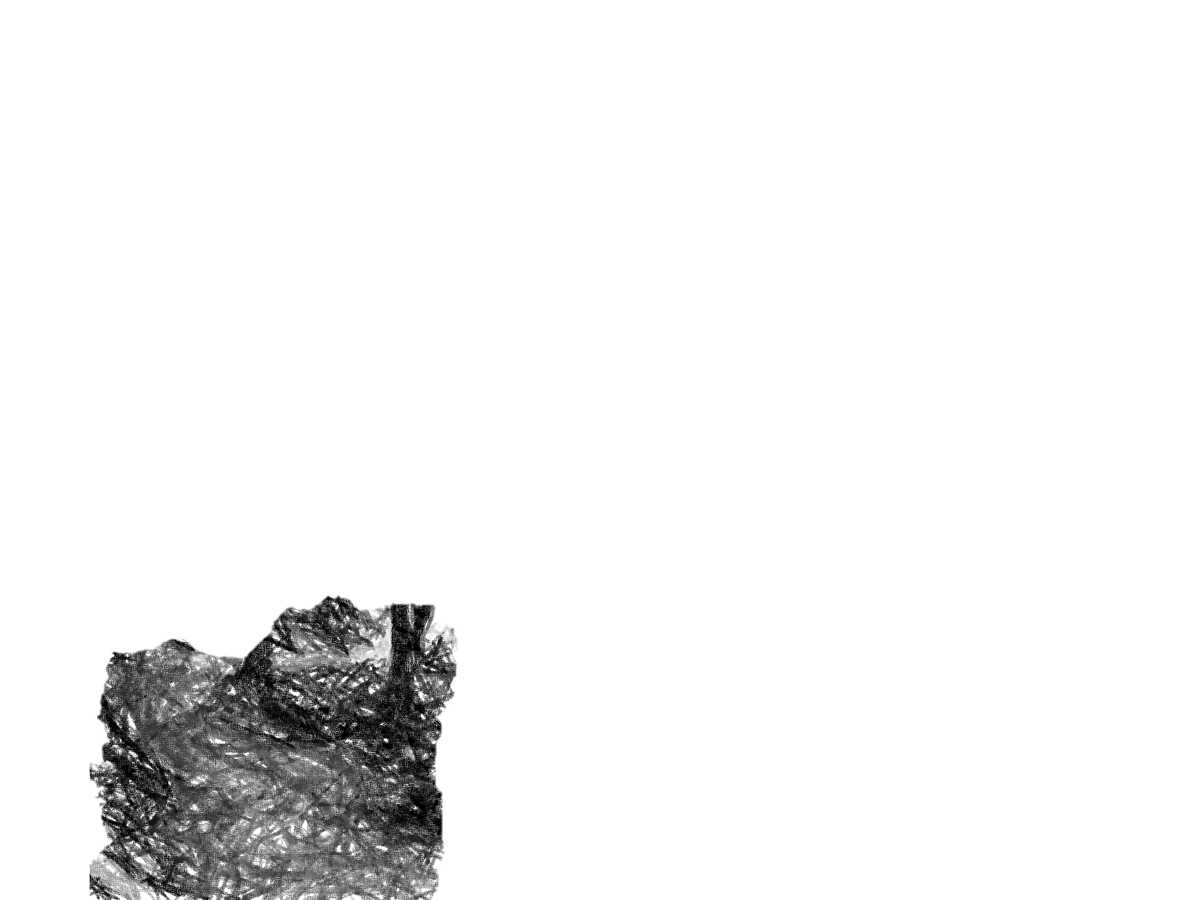

Slide 24


Slide 25
Advantage
Advantage
Advantage
Advantage
Disadvantage
Disadvantage
Disadvantage
Disadvantage
Disadvantage
Advantage
Disadvantage
Advantage
Disadvantage
Advantage

Slide 26


Majority vote
X
Mayer
Hopkins
Miller

Slide 27

Majority vote
Feature n Target feature
Feature 1 …
…
…
…
…
Instance 1
Instance 2
…
…
Instance n

Slide 28
Feature 2
False
True
True
Feature 1
Feature 1
False
Feature 2

